Slide 1
CONNECT TO HANA DB.
Milind Parab

Slide 2
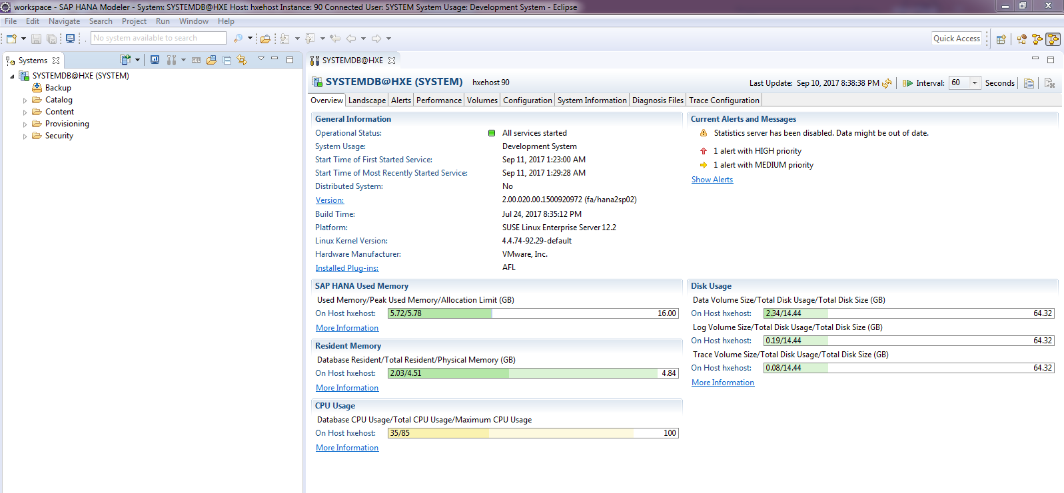
Make Sure HANA is UP and Running.

Slide 3
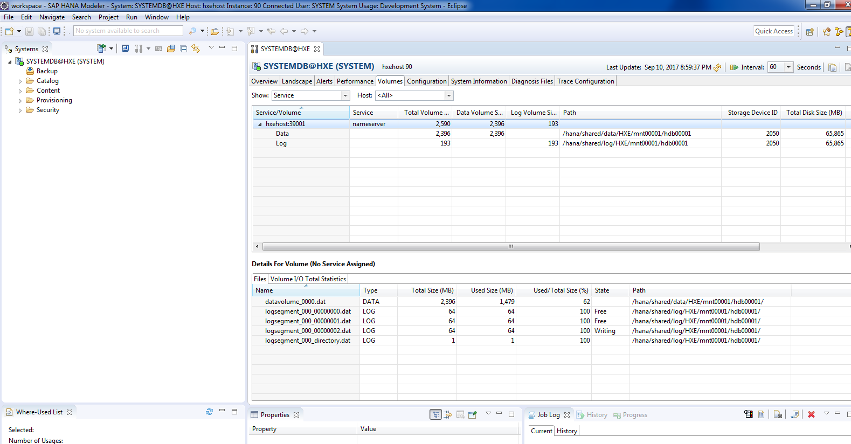
Cont.

Slide 4
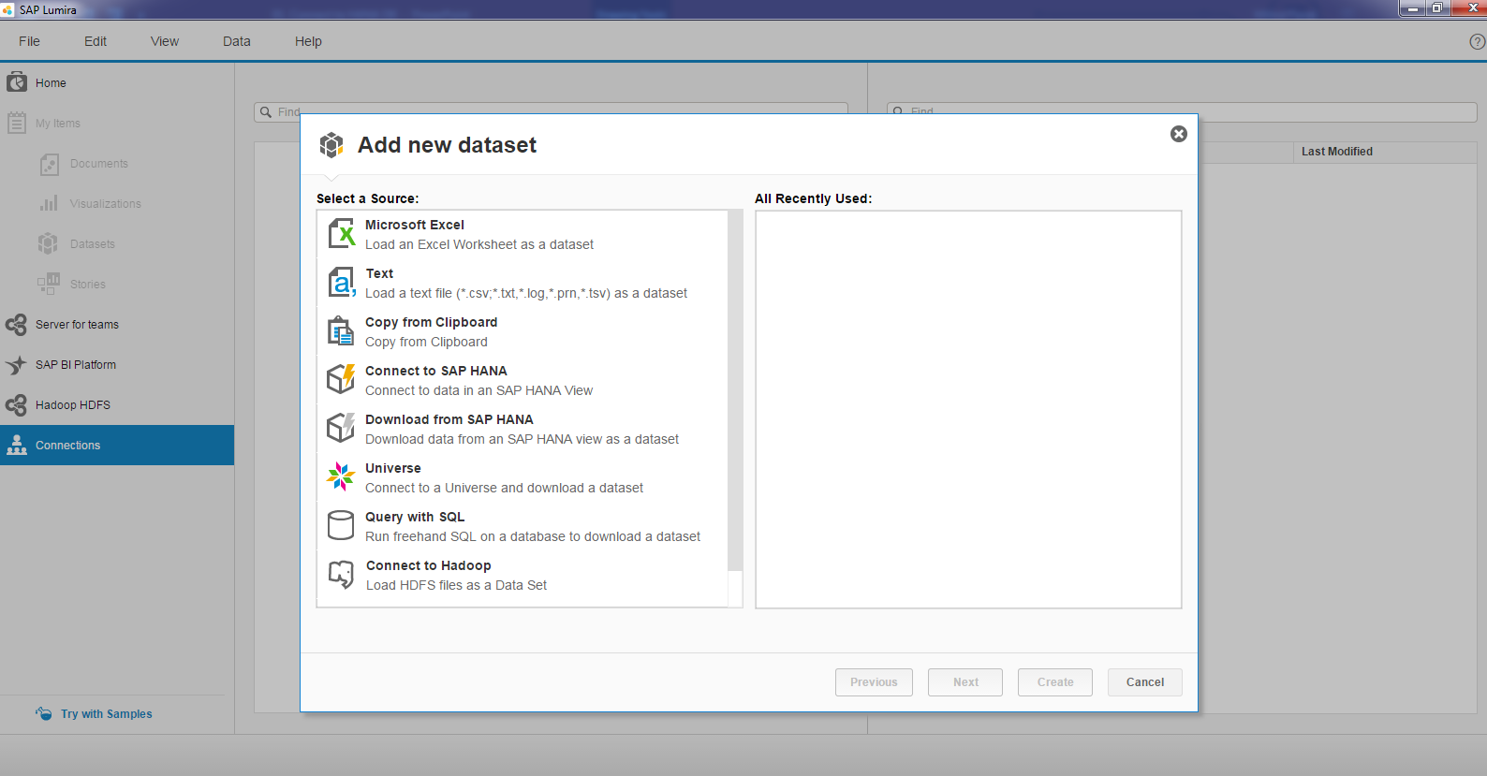
File → New → Download Data From SAP HANA.

Slide 5
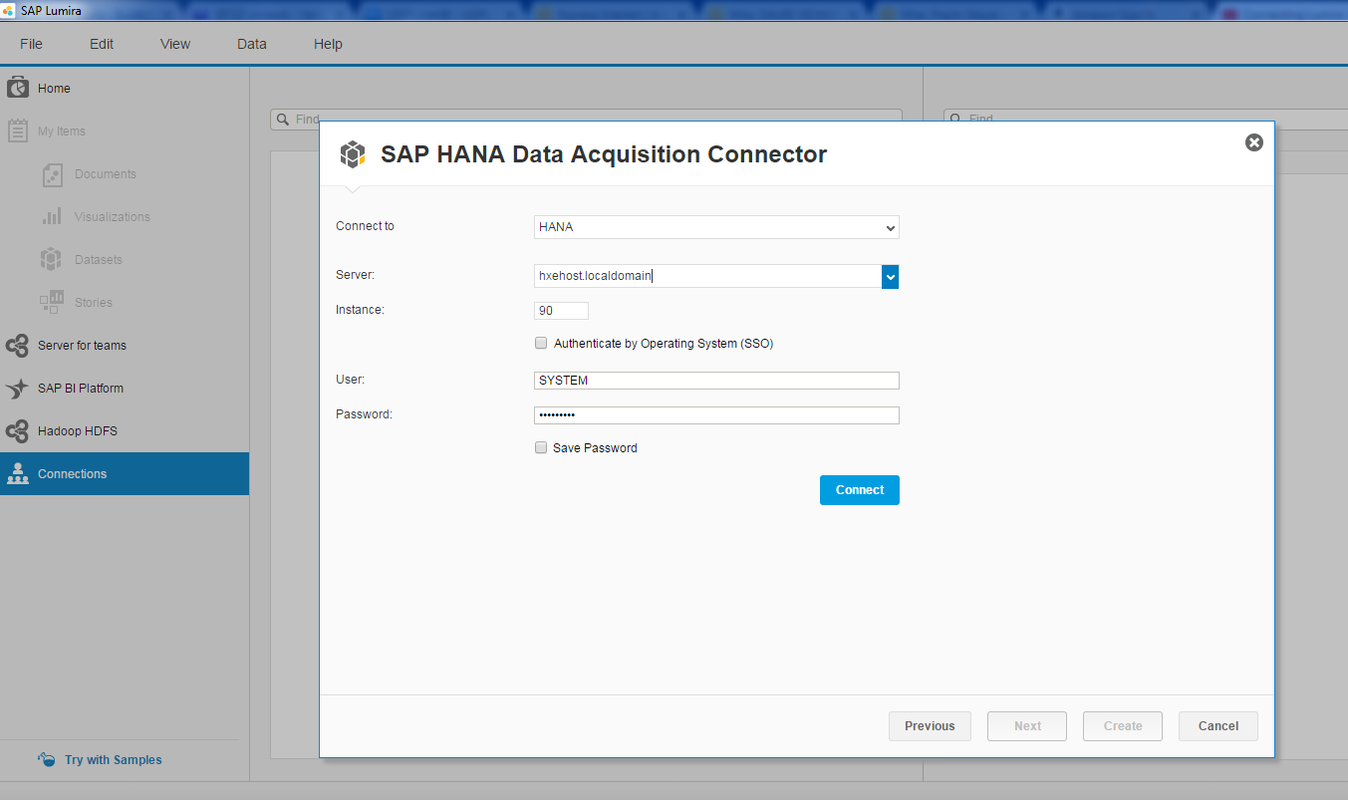
Update HANA Server Info.

